Slide 1
Farm Stress and Agriculture Suicide Prevention October 5th, 2021

Slide 2
1996

Slide 3
February 2019

Slide 4
CDC Reported Data
National
47,000 people died by Suicide in 2017
Farmers 2-3 times the national average
Rates increasing year over year
Washington State
17.5 deaths per 100,000
Rural areas are 24% higher
21.2 per 100,000
8th leading cause of death

Slide 5
Centers for Disease Control and Prevention Data
54% had no known mental health condition
Suicide is the 3rd leading cause of death for 15-24 year-olds
Self Reported Suicidal Thoughts:
Ages 18-25: 10.5%
Ages 18 and up: 4.3%
Notes:
54%. More than half of people who died by suicide did not have a known mental health condition.
4.3% of adults age 18 and older in the United States had thoughts about suicide in 2017. Among adults across all age groups, the prevalence of serious suicidal thoughts was highest among adults aged 18-25 (10.5%).
https://www.nimh.nih.gov/health/statistics/suicide.shtml
https://www.cdc.gov/vitalsigns/suicide/index.html
https://kidshealth.org/en/parents/suicide.html

Slide 6
Agriculture is a Stressful Occupation
Production
Financial
Operational
Weather
Yields
Pests and Diseases
Animal Health
Long Hours
Equipment Breakdowns
Injuries
Fluctuating Market Prices
High Costs
High Debt Loads
Tariffs
Bankruptcy
Multigenerational Farm
Family Dynamics
Work/Life Balance
Off-Farm Occupation
Notes:
To farm these days a person must be resilient. They’ve got to be absolutely dedicated, there's no halfway in farming. There are ag specific stressors that must be faced daily.
Production Based
Financial
Operational

Slide 7
Barriers Facing Rural Communities
Access to care
Isolation
Finances
Trauma
Chronic Pain
Exposure to Chemicals
Substance Abuse
Access to Lethal Means
Stigma

Slide 8
National Crisis Lines
Notes:
No one expects you to be a behavioral health expert in 30 min. But lets say between now and the upcoming trainings you start to observe some of the warning signs in your community. What do you do
Take out phone, go to contacts. Enter the suicide prevention lifeline. This is a free, confidential service that is offered to anyone in a moment of crisis. There are language services available for translation and the trained support staff are there to listen and help.
741741 is a text line that can be very helpful for certain populations that are more apt to text over talk.
Like any emergency tool, you want to be familiar with how to access them. I encourage you to take down the number. ?Encourage to call/reduce stigma/and and ?
Indicate Spring Mental Health First Aid – thank Mike Gaffney for foresight
QPR – Based in Spokane

Slide 9
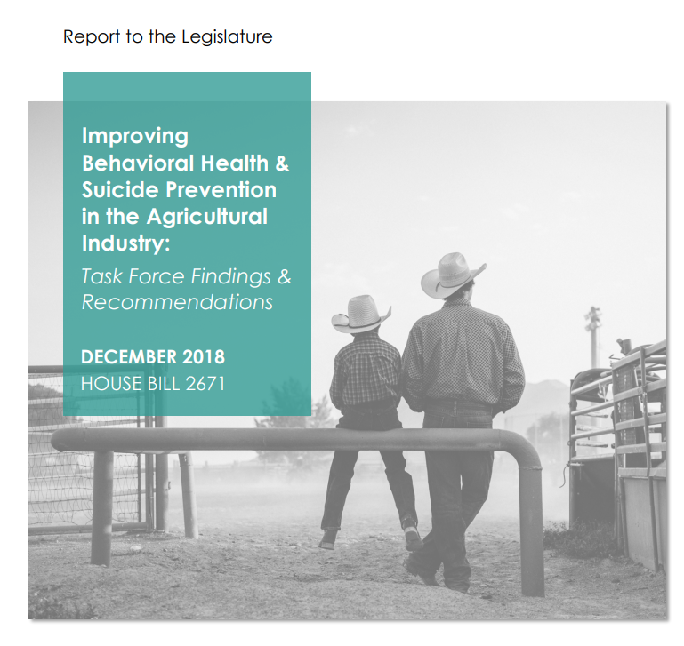
Washington State Department of Health House Bill 2671 March 2019- Current
WSU Skagit Agricultural Suicide Prevention Pilot Program
Notes:
Approached by WA DOH….

Slide 10
Farm and Ranch Stress Assistance Network Round 1
Establish a diverse, regionally-representative network of member organizations.
Develop a clearinghouse of farmer assistance programs in the region.
Educate individuals/team in your region about FRSAN activities and how they can access resources
Target Audience:
Farmers in Washington &
Oregon State
Notes:
Good news is that in the face of these trends we have an opportunity to build a support network and bring necessary resources to our communities.
Information regarding FRSAN
Identify our program and partners:
Western Regional Agricultural Stress Assistance Program (WRASAP): OSU, VOA WW
Objective 1: Establish a diverse, regionally-representative network of member organizations.
Objective 2: Develop a clearinghouse of farmer assistance programs in the region.
Objective 3: Educate individuals/team in your region about FRSAN activities and how they can access and use existing resources and programs in their work with agricultural workers and communities under stress.

Slide 11
Farm and Ranch Stress Assistance Network Round 2
Western Region:
13 States
4 Territories
10+ Languages
Major Partners:
Land Grant Universities
Montana State University
Farm Aid
National AgrAbility Program
Notes:
Good news is that in the face of these trends we have an opportunity to build a support network and bring necessary resources to our communities.
Information regarding FRSAN
Identify our program and partners:
Western Regional Agricultural Stress Assistance Program (WRASAP): OSU, VOA WW
Objective 1: Establish a diverse, regionally-representative network of member organizations.
Objective 2: Develop a clearinghouse of farmer assistance programs in the region.
Objective 3: Educate individuals/team in your region about FRSAN activities and how they can access and use existing resources and programs in their work with agricultural workers and communities under stress.

Slide 12
Approach
Baseline Analysis
Farm Stressors
Ideal Resource Delivery
Network
Identify Aligned Stakeholder Organizations
Leverage Resources
Collaboration and Problem Solving
Outreach
Curriculum Development and Evaluation
Peer to Peer Support
Community Trainings
Direct Services
Clearinghouse of Resources
Farmer Support Hotline
Notes:
Total Farmer Health

Slide 13
Farm and Ranch Stress Assistance Network
Regional SRAP Partners:
Alaska AgrAbility Project
California AgrAbility Project
Colorado AgrAbility Project
New Mexico AgrAbility Project
AgrAbility of Utah Project
Washington State AgrAbility Project
Notes:
Information regarding FRSAN
Identify our program and partners:
Western Regional Agricultural Stress Assistance Program (WRASAP): OSU, VOA WW
Objective 1: Establish a diverse, regionally-representative network of member organizations.
Objective 2: Develop a clearinghouse of farmer assistance programs in the region.
Objective 3: Educate individuals/team in your region about FRSAN activities and how they can access and use existing resources and programs in their work with agricultural workers and communities under stress.

Slide 14
WRASAP Services 2021
Farmstress.us
Clearinghouse
Minigrants
Professional Development
Translation
Outreach
Farmer Resource Hotline
1-800-FARM-AID
1-800-327-6243

Slide 15
Survey

Slide 17
Look for signs
Are you or someone you know experiencing:
Change in routine
Decline in care of farm and/or livestock
Change in mood (anxious, agitated, angry)
New or increased financial pressures
Loss of interest in hobbies/activities
Gifting of prized possessions

Slide 18
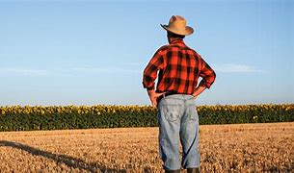
Don’t be afraid to act
I am probably not atypical in that I find the topic of suicide in ag an uncomfortable topic that I shy away from. I am normally an outgoing and very “reach out kind of a guy” but not for this topic. There is just something about, some stigma or taboo. However, I was a speaker on an agenda where Skagit County Extension Director Don McMoran gave a presentation on the topic including things to be on the look out for. This was on a Friday this past mid March. On Wednesday of the following week I was meeting with some growers and one grower mentioned to me that the grower that I was going to visit next needed some cheering up as he seemed “down.” I met with the person and within the first ten minutes he was talking about wanting to get out of agriculture and was saying some down things. I pointed out that he seemed in a dark place and that I was concerned about him. Asking him pointedly if he was having some problems triggered an outpouring of negativity and a description of his problems. We talked some more and later we concluded our meeting he seemed better and we each moved on. Emotional outreach like this is not something that comes natural to me so part of me just wanted to exit the scene.
As I drove away and processed what just happened, I call this person’s wife and talked in general about what happen. She expressed some serious concerns about his situation and their situation. After that happened I called Don McMoran and told him that what happened. He encouraged me to get more involved. Although I was an hour in to a five hour drive home, I turned around and went back to talk to this guy. I started looking for him and found him, in a place he should not have been in (do not draw conclusions). I told him that I wanted to talk. He said he could not as he had something to do. I told him I would wait until he could talk. He gave me a time and location in about half an hour. In the mean time I called someone who knew a mental health counselor. I talked to that person and got some names of counselors. I met with the grower and had an even more pointed conversation and laid out my concerns. I pointed out the several signs that Don had mentioned and said that in 30 minutes of talking with him, he touched a half dozen.
Then he really opened up and was oddly very specific about the challenges that he was facing. I gave him the names of the counselors. He promised me he would call and make an appointment. Later he contacted me and told me that our meeting meant a lot to him, and that it helped. His wife contacted me and said that it made a difference. I have kept in touch with the grower and he is coming over with his wife to visit up in a few weeks. He made the call and made an appointment with a counselor.
I have no idea what the outcome would have been had I not turned around and gone back. Do not care to think about it. I do know that if Don had not given that talk I doubt I would have turned around.
Thank you Don.

Slide 19
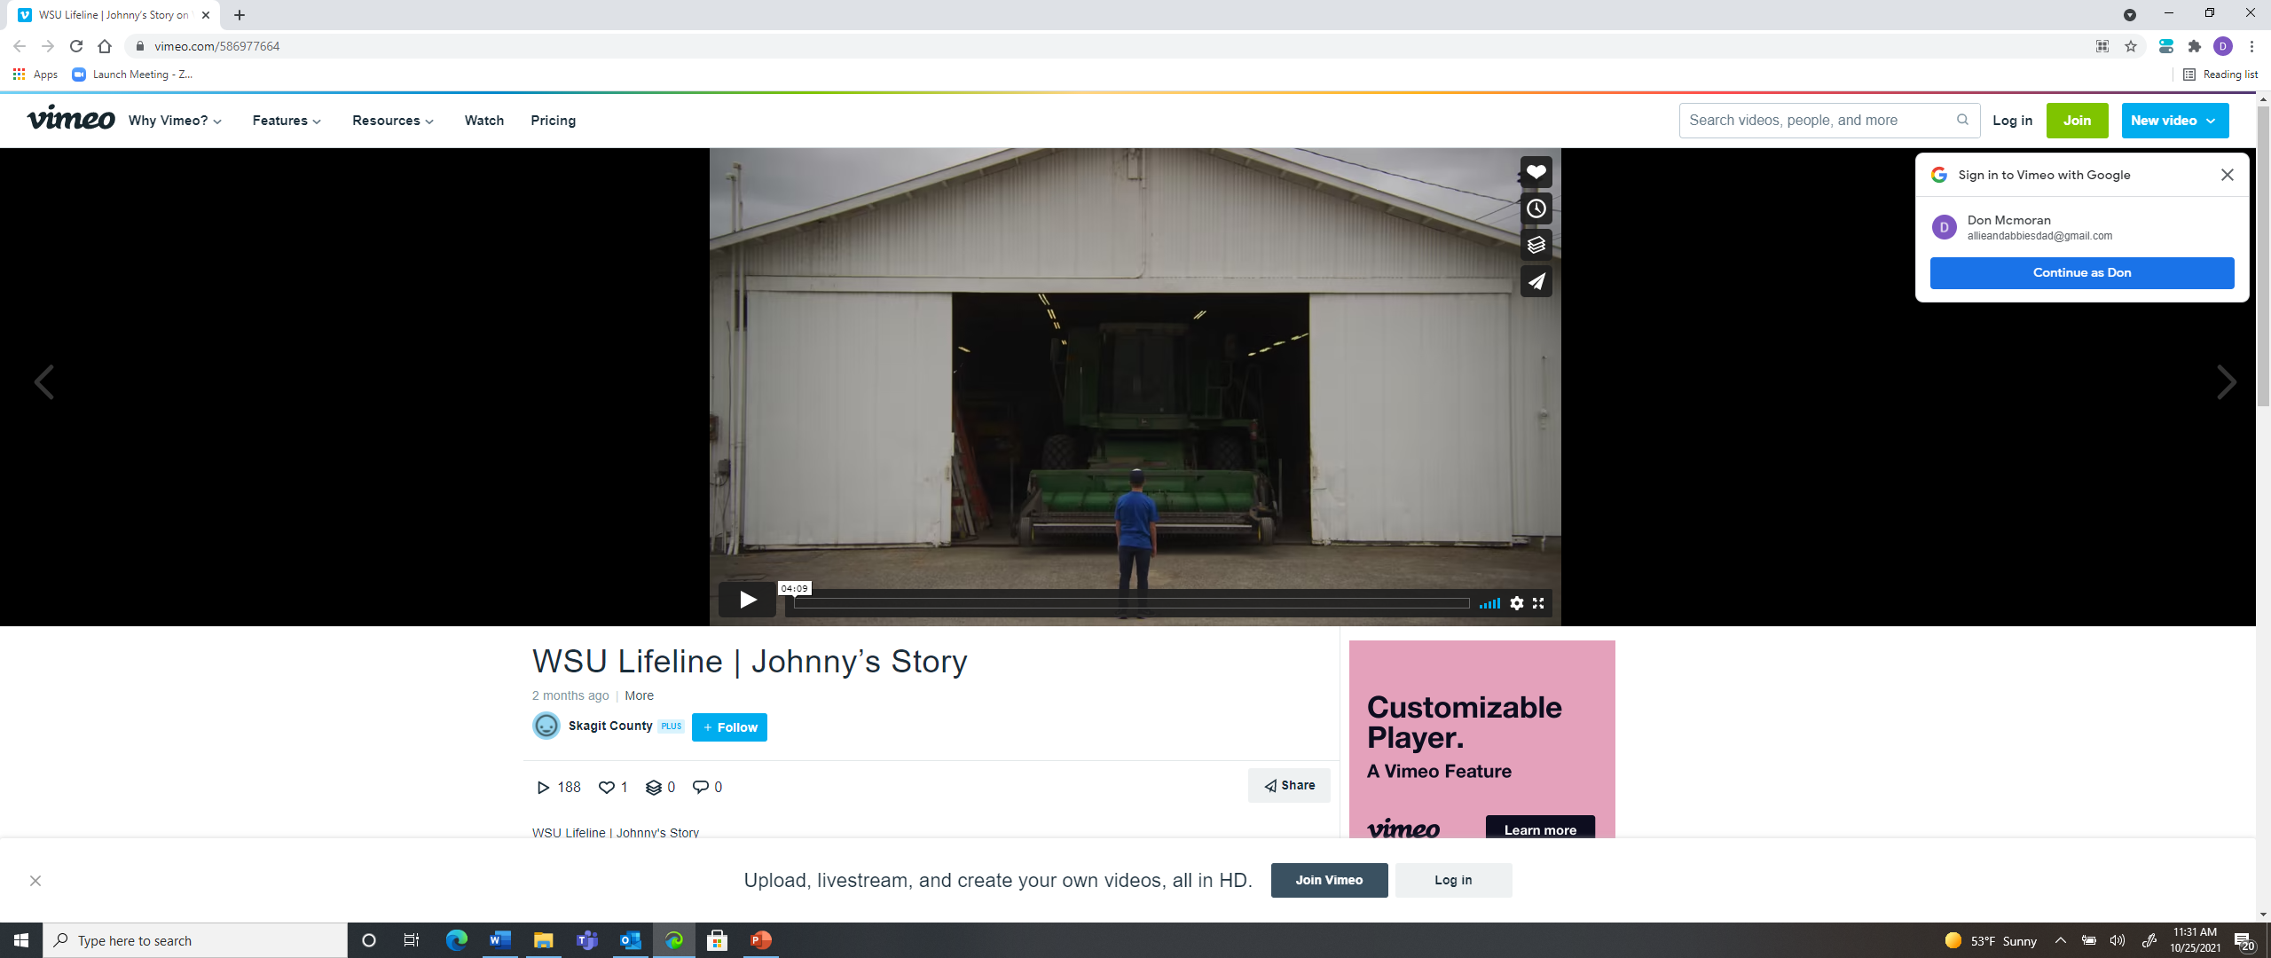
Videos
Johnny: https://vimeo.com/586977664
John’s Story: https://vimeo.com/586975952
Ellen’s Story: https://vimeo.com/586974282
Ed and Maria’s Story: https://vimeo.com/586985699

Slide 20
Commercial
https://vimeo.com/626669003

Slide 21
Promotional Materials

Slide 22
Contact Info
Don McMoran
Agriculture and Natural Resources Extension Faculty
County Director
WSU Skagit County Extension
dmcmoran@wsu.edu

