Slide 1
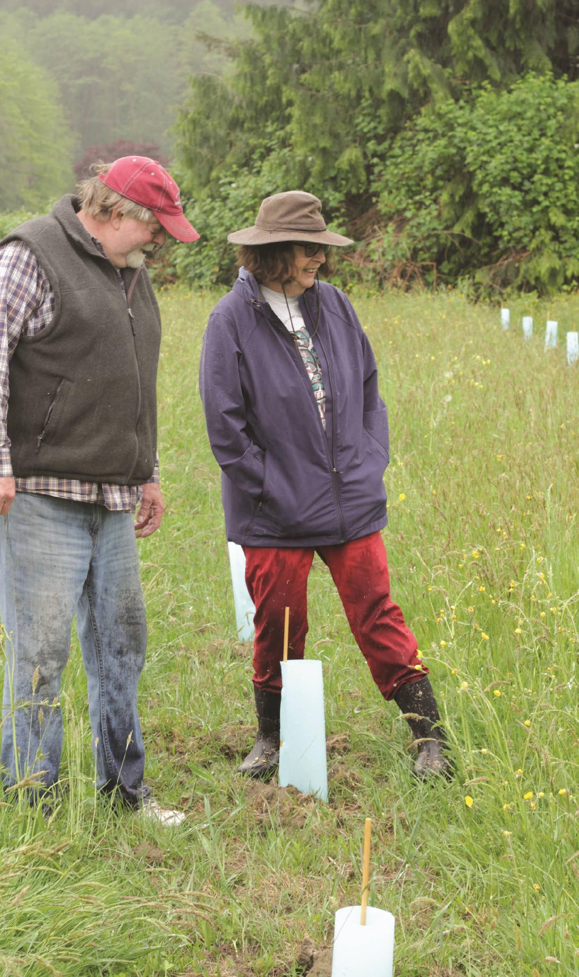
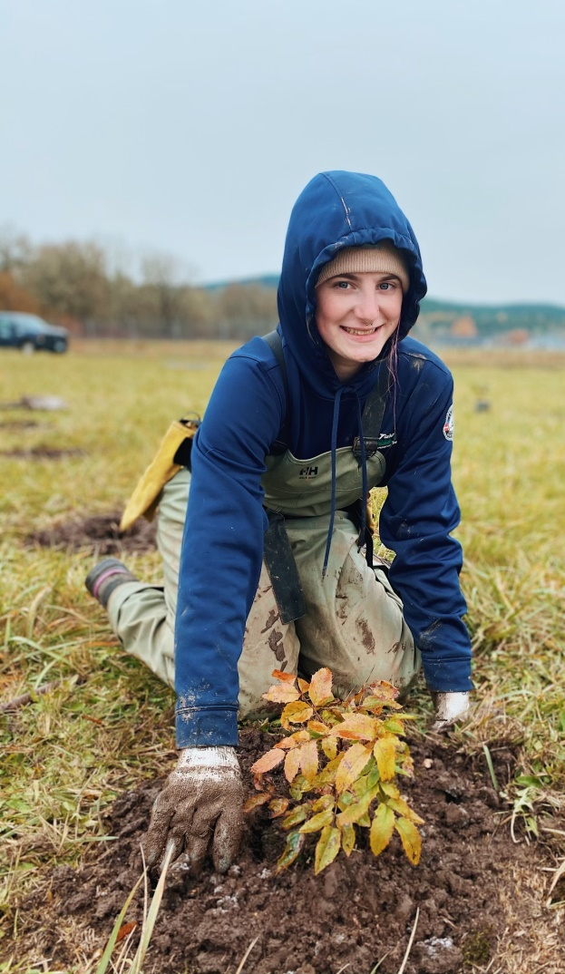
EDUCATION
STEWARDSHIP
WORKING LANDS
Notes:
‹#›

Slide 2
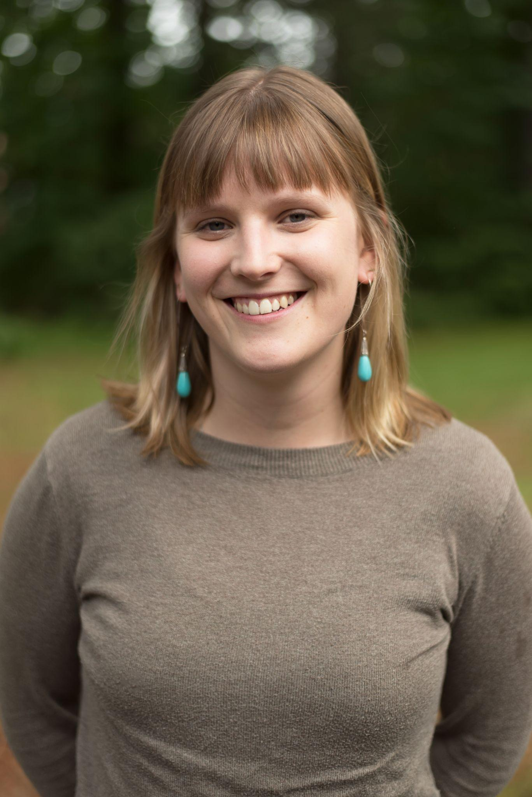
Meet Your Presenters
Nora Carman-White
Thurston Conservation District, Communications & Education Manager
Notes:
‹#›

Slide 3
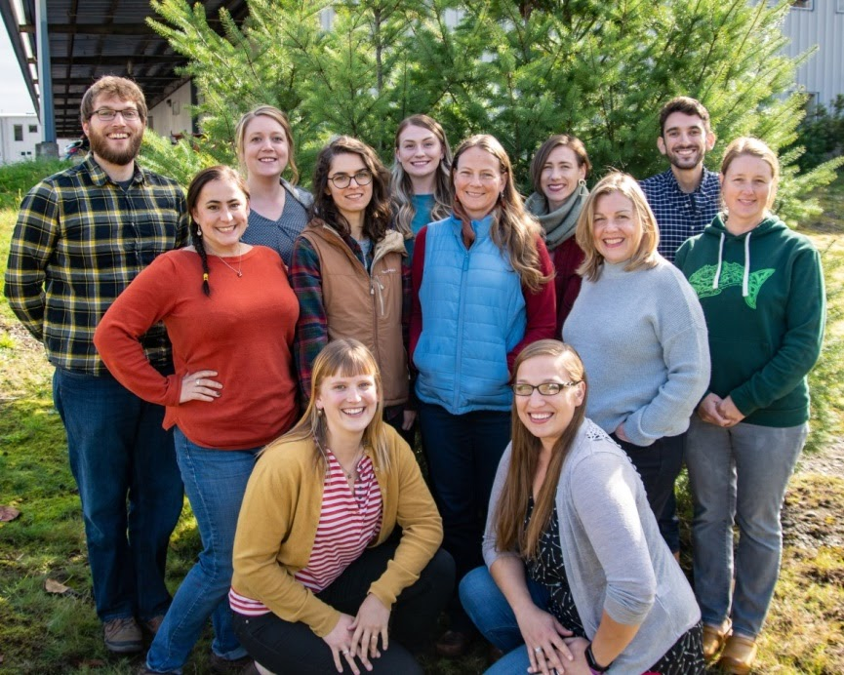
What are Conservation Districts?
Notes:
Here at Thurston CD, we’ve been working with local residents since 1947. We serve residents of Thurston County who residen upon the Indigenous Lands of the Nisqually, Chehalis, and Squaxin Peoples. We are one of 45 Districts in the State of Washington and there are over 3,000 Soil and Water Conservation Districts nationally.
Conservation Districts were formed in the 1930s as a local, place and community-based response to natural resource concerns. Our origins are actually in large part due to the emergency of the Great Dust Bowl. Nationally since the 1930s, conservation districts provide incentive-based programs, education, and non-regulatory technical assistance that make it accessible and more affordable for private landowners and residents to implement conservation on their property or in their home.
All of our work is non-regulatory and voluntary. And because conservation districts are locally oriented we are able to build our programming and offerings around the needs of our local community.
‹#›

Slide 4
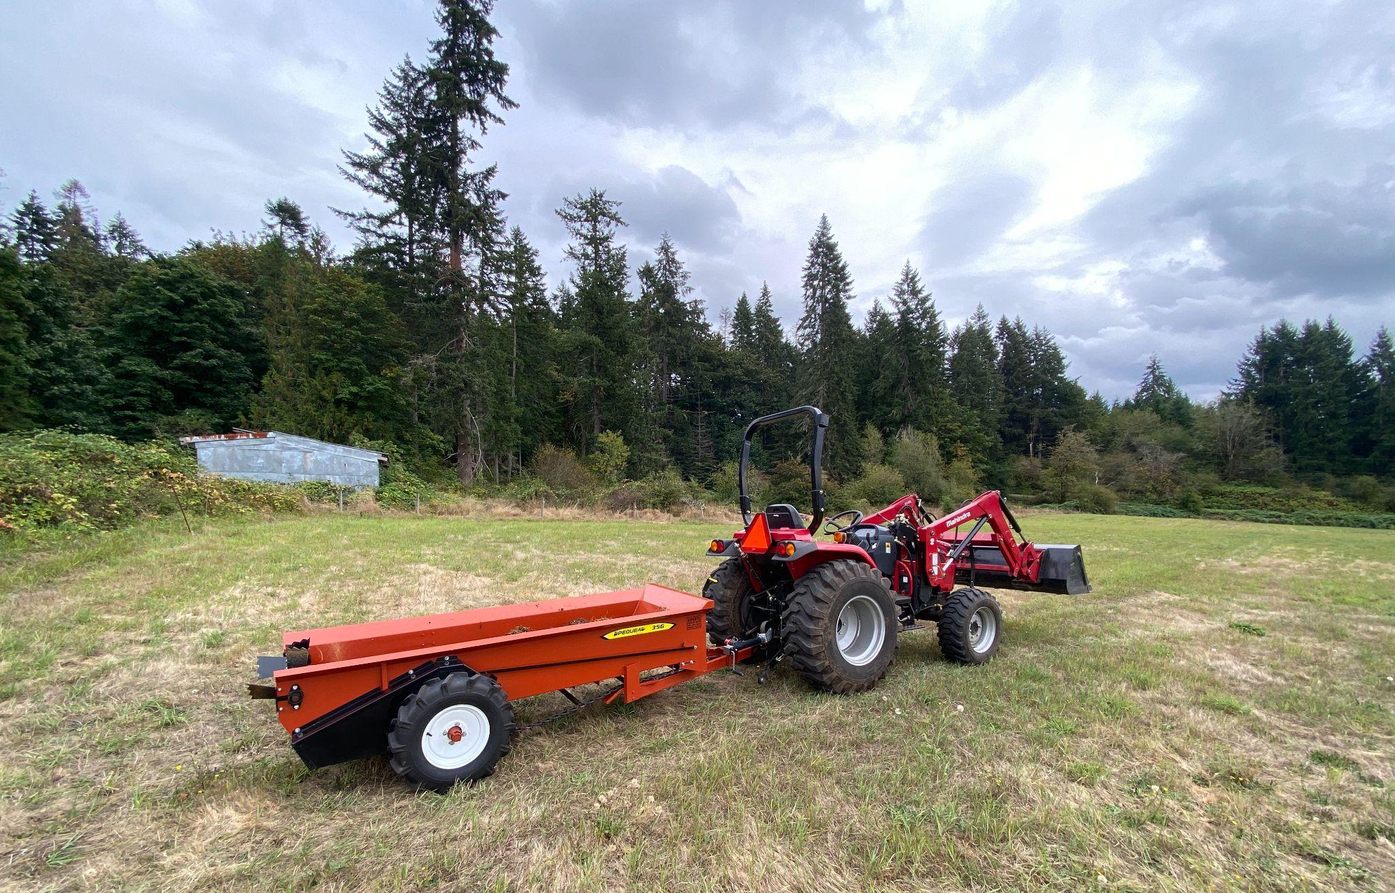
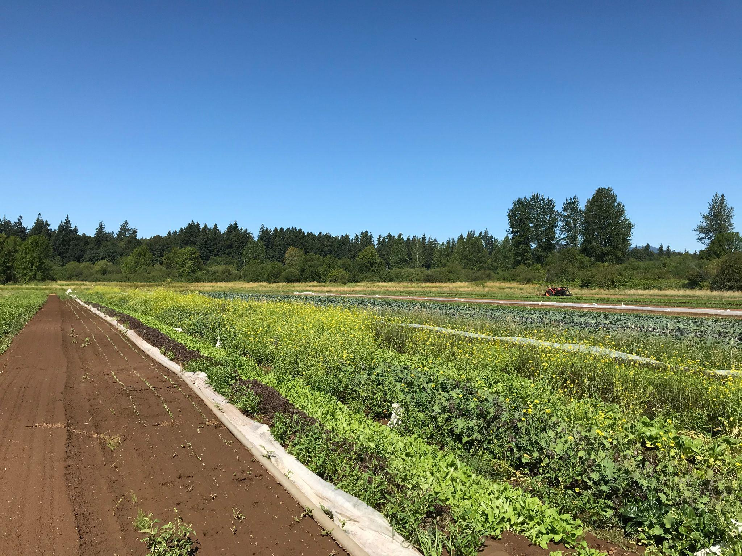
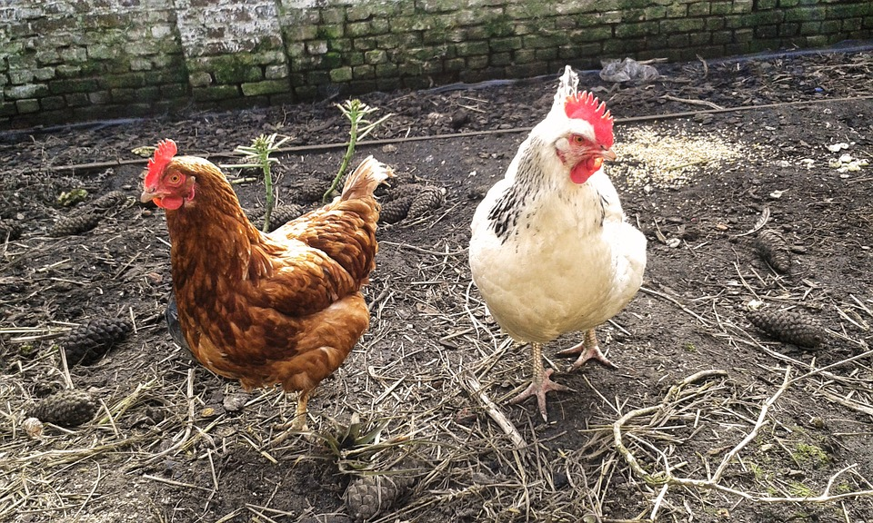
Supporting Local Agriculture
Providing education, funding and resources for all stages and sizes of agricultural operations.
Creating pathways to connect farmers to markets
Preserving farmland
Notes:
The origins of Conservation Districts is really around supporting local agriculture while also not depleting natural resources. Over the years, our recommendations and forms of assistance have changed to match best available science and the changing needs of our local agricultural economy.
In much of our technical assistance work, we collaborate with community members to create workable solutions for their goals while also restoring our local natural resources. This could look like conservation planning and guidance, a one off planting plan, a site visit where we take time to look at a property and provide conservation recommendations, or a simple phone conversation. We work to meet someone’s goals while also improving habitat.
‹#›

Slide 5
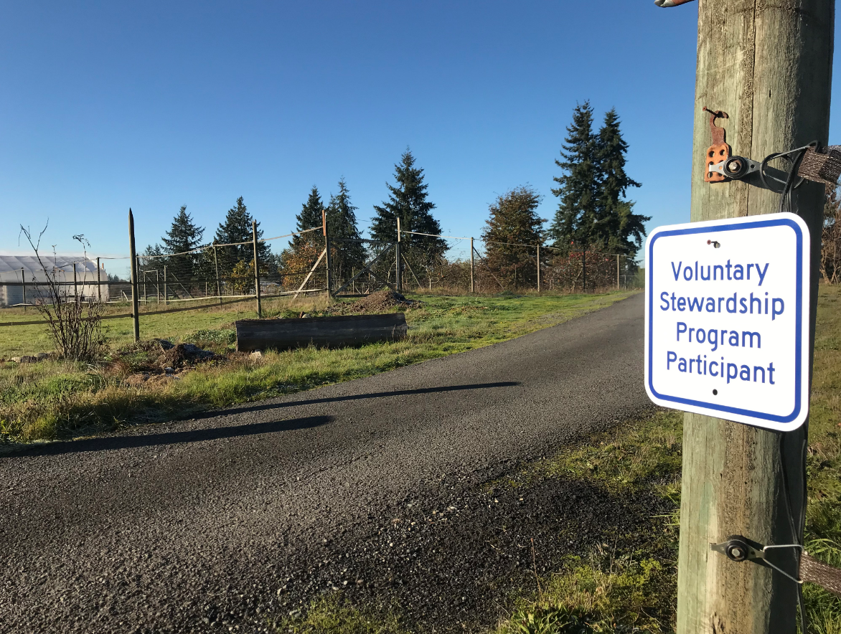
Voluntary Stewardship Program
Notes:
I on particular wanted to highlight the Voluntary Stewardship Program, or VSP. This program is a great example of how Conservation Districts work with agricultural producers to meet their production goals while also considering our specific and important natural resources. Engaging with something like VSP can be a step to proactively thinking about your landscape and how it might interact with or be impacted by something like a climate disaster.
VSP is also great entry point into working with the District and making sure you and your farm are connected to your network of local service providers.
The program works with residents who are practicing agriculture, no matter the scale, and who also have what is called a critical area on their property - this includes things like wetlands, aquifer recharge soils and sensitive habitat. VSP provides an alternative to regulation for the management of critical areas where they overlap with agricultural activity. Through the program, our staff works directly with you to develop an Individual Stewardship Plan.
An Individual Stewardship Plan is sort of like a farm plan lite and can be a great way to start getting connected with other resources and tools from the District. If you’d like to learn more, I’ll place a link to our VSP page on our website in the chat at the end of my little section.

Slide 6
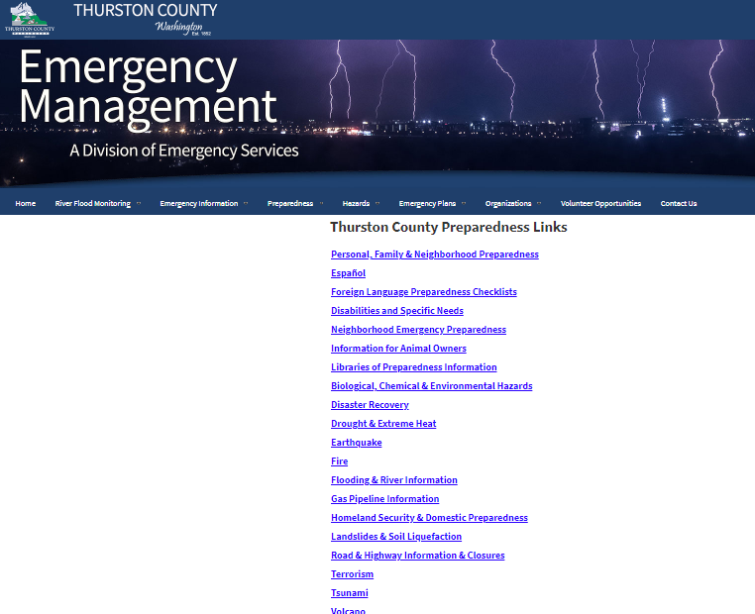
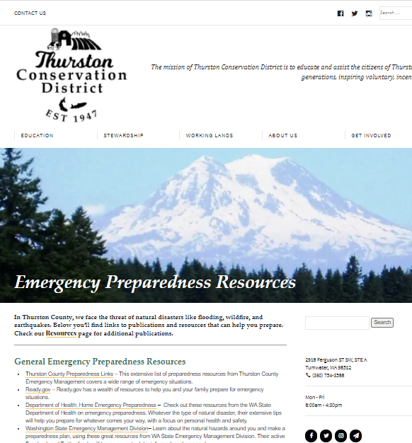
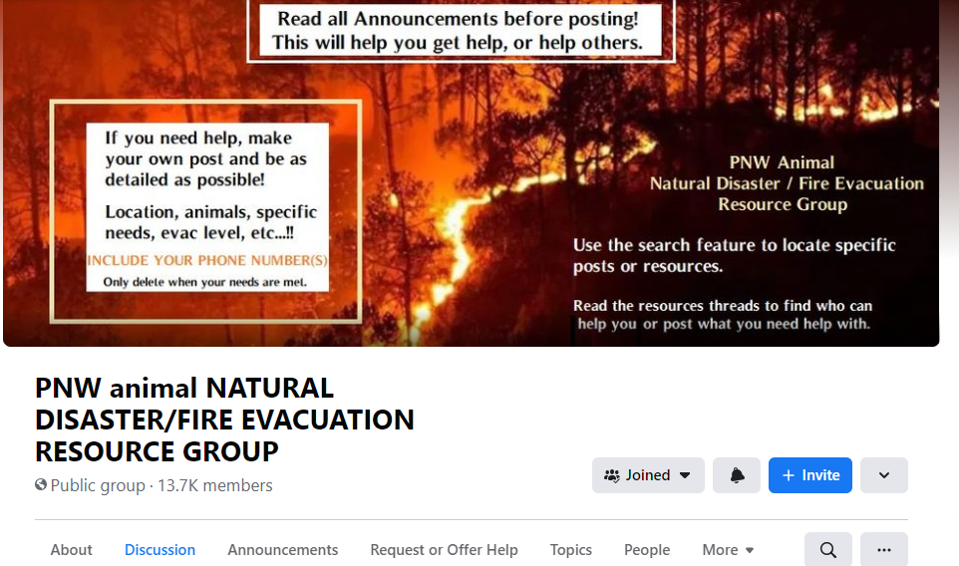
Know Your Resources
https://www.thurstoncd.com/education/resources/emergency-preparedness-resources/
https://www.thurstoncountywa.gov/em/Pages/ei-alert.aspx
Notes:
Preparing your farm, selves, and property for emergencies is really a situation where knowledge is power and forethought will help you out! So engaging with something like the Voluntary Stewardship Program can be a piece of that, and knowing what other kinds of resources are out there is also really important.
We have so many knowledge resources at our fingertips, and a great and easy emergency preparedness step you can take is to look at those BEFORE there’s an emergency.
>>Some of my top recommendations are to sign up for Thurston County Emergency Alerts which you can sign up to receive both text and email notifications of local weather and climate emergencies. We’ve all probably also experienced the Wireless Emergency Alerts that automatically come to your smartphone. That is a national system that cell phone carriers opt into to provide people with alerts related to natural disaster, national emergencies, Amber Alerts and such. Signing up for Thurston County alerts can make sure that you’re covered for all of the potential information that would be helpful. You can sign up on their website - the link is here on the screen and I’ll post links in the chat after this.
>>Social media can also be a great way to make sure you are pre-connected to resources. For example, groups like the PNW animal NATURAL DISASTER/FIRE EVACUATION RESOURCE GROUP on Facebook were really helpful in making sure that farms and livestock were evacuated in Oregon and Washington during summer 2020. Many of our small local fire departments also maintain Facebook pages where they offer resources and provide updates on local fires.
>>Thurston Conservation District maintains an Emergency Preparedness Resource library on our website that links to many of these and more. Take half an hour to browse and see what looks helpful and relevant to you and your farm. I’ll also post this link in the chat.
Next we’ll cover some physical preparedness actions you can take on your farm to mitigate for natural disaster and climate emergencies.

Slide 7
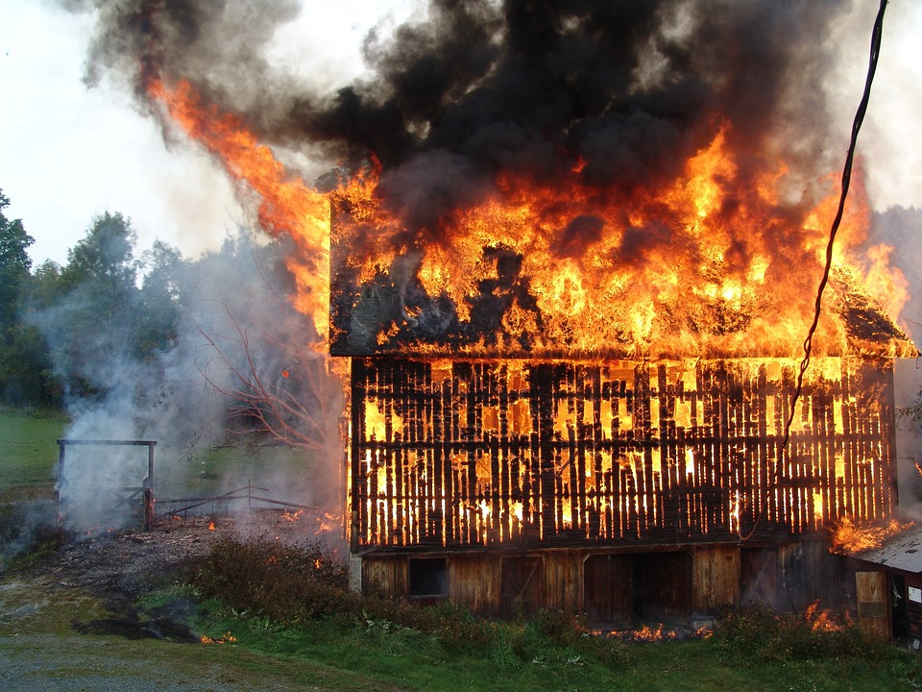
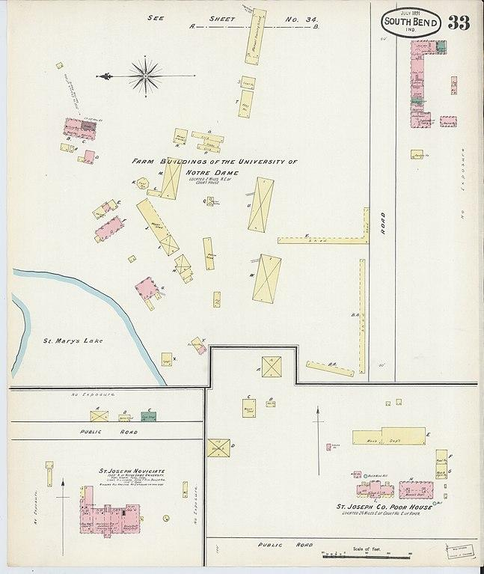
Climate & Natural Disasters: Fire & Heat
Clear danger zone around your structures
Maintain vegetation
Check electric features
Think about storage - fuel, feed, hay, firewood etc.
Signage & map resources
Notes:
Fire is one of those things that sometimes you have the opportunity to evacuate for, especially if it’s part of a wildfire that is nearing your home, and sometimes is a site fire. There are things you can do to minimize your risk for both.
On-site structure fires might include things like heat lamp fires or other electrical fires, sparking electrical fencing, vehicle sparks, or combustion from too damp of hay held in storage. These are generally accidents which have a distinct source. Doing things like maintaining vehicles and fencing, dusting heat lamps regularly, and not storing high moisture hay can reduce risk for these. When these accidents do occur, it’s really important to make sure they don’t become the ignition for a larger wildland fire. Having a good map of your site, especially including things like where extra fuel is stored, where propane or heating oil tanks and lines are, and where water sources for fighting a fire are is really critical to include in a map like that for both your own reference and responder’s reference.
Risk of wildfire, especially in the urban wild interface - where many small farms are located - is increasing with more drastic drought weather in the summer and increased population density. Some of the best things you’re going to do to increase your resiliency to fire are the same as for your homes - for example: clearing an ignition zone around your home and around any of your farm structures, making sure you’re maintaining the vegetation around your structures to reduce fuel ladders, and also considering what built features could act as fuel ladders. This might include things like wooden fences that are in direct contact with your home, barns, or other buildings which can serve to bring a fire closer to structures.
Heat is another consideration that we all got a taste of this summer with the heat wave. These kinds of extreme events are increasingly likely with climate change. Hot and dry weather obviously increases risk of fire, but brings its own risks as well. Making sure there is shade and water for all the humans and critters on your property, taking frequent breaks, hosing down animals if necessary, definitely being on alert for fire danger are very important in-the-moment things we can do. In the long term, adaptive planning is going to be critical and can look like planting more heat tolerant varieties and kinds of plants, improving irrigation efficiencies, and building farm infrastructure with weather extremes in mind.

Slide 8
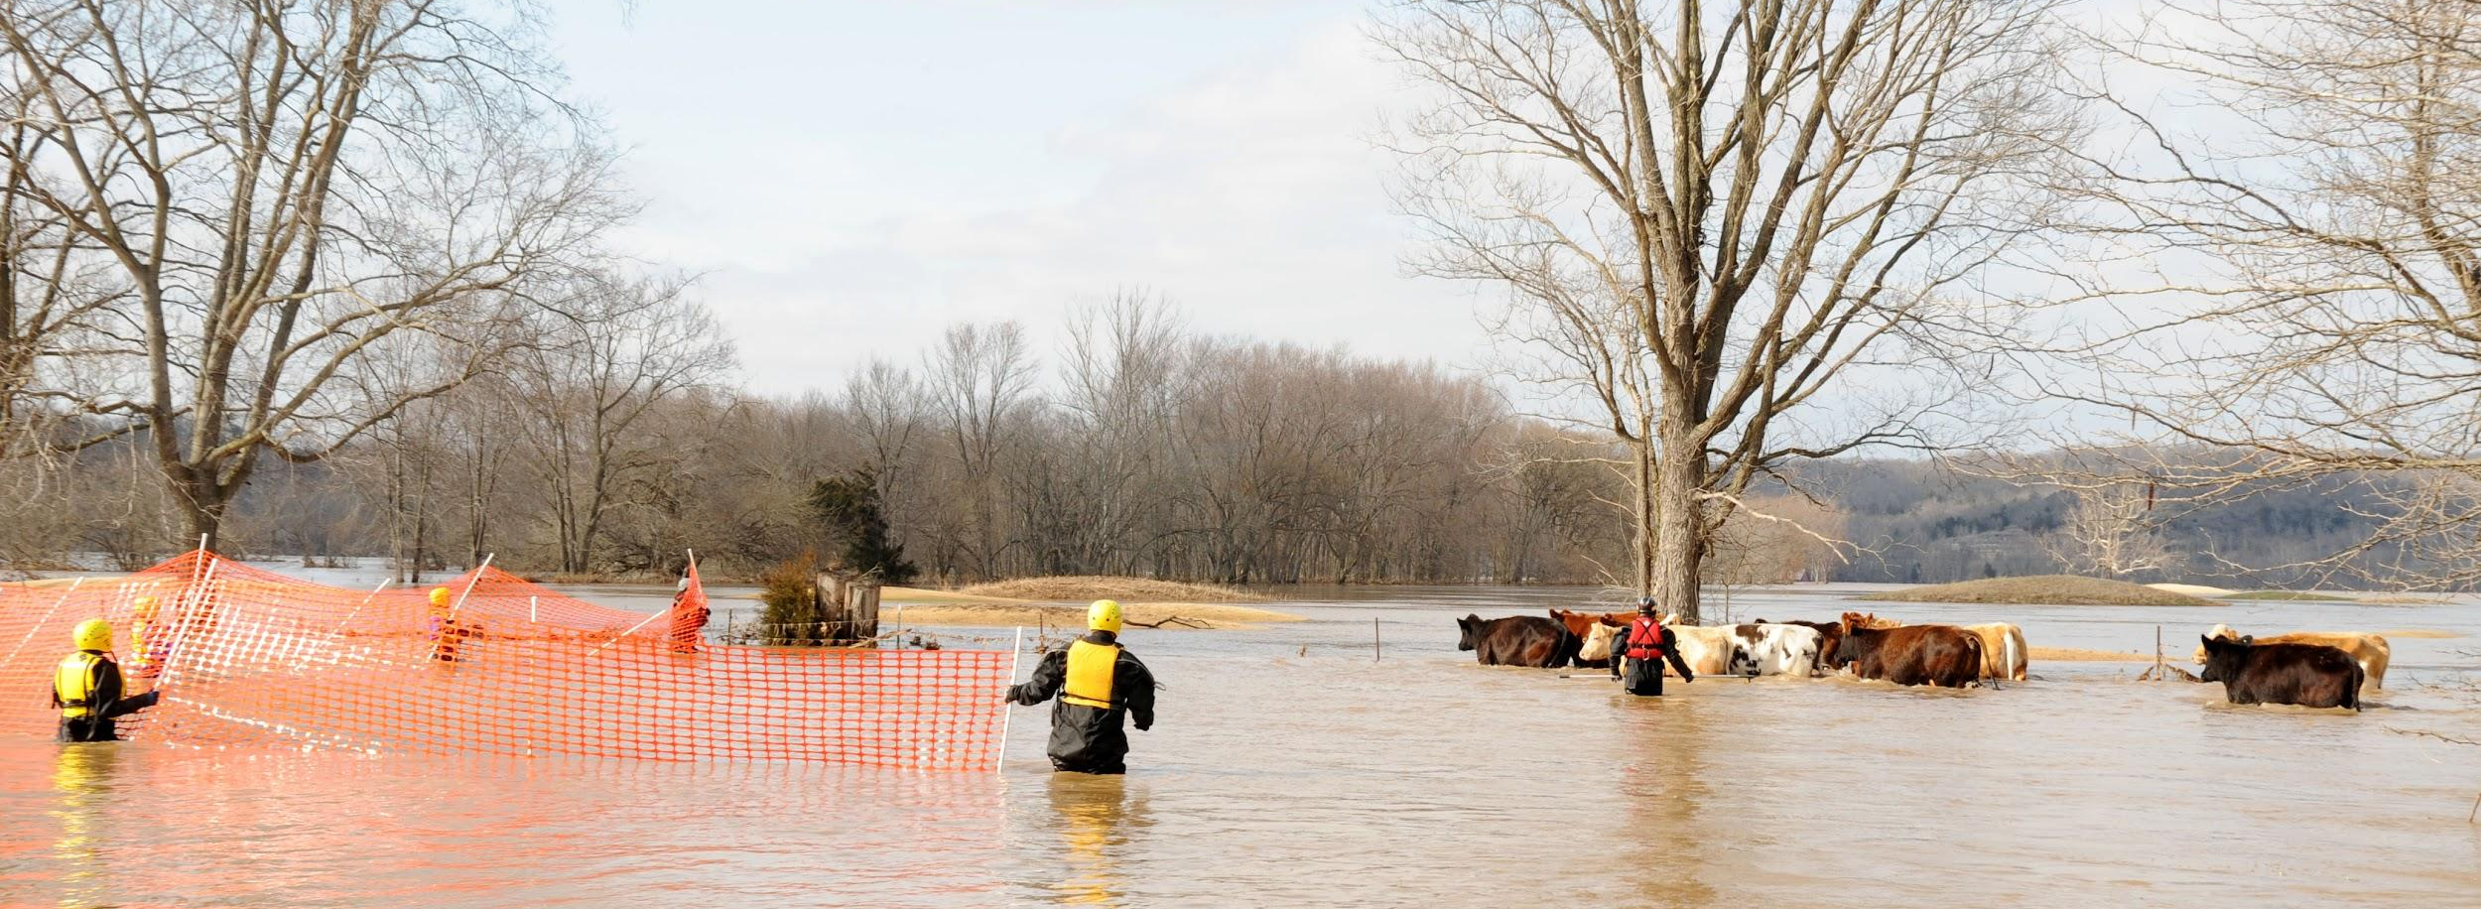
Climate & Natural Disasters: Rain & Flooding
Wind, Rain, and Snow
Structure & tree integrity
Vehicle placement
Alternative power source/heat source
Emergency stock of fuel, feed, and food
Flooding
Know your risk
Know evacuation routes
Have a high ground plan
Get your well checked
Notes:
This same kind of short-term action and long term planning is useful for the other end of the season spectrum when you might be experiencing heavy rain or snowfall, wind, flooding, and cold weather.
FLOODING
You should know if you already live in a flood prone area, but if you’re unsure or want to look at more maps to see your risk I recommend using the Thurston GeoData tool and using the flood map and other waterway layers.
If you do live in a flood zone, this is where our previous information about making sure you’re signed up for emergency alerts is really important. This will help you have the most amount of time to evacuate or move your equipment and livestock out of a flood area. Having a pre-made plan about where you’re going to move stuff or what route is best for getting out of a flooded area is a good plan.
If you do experience flooding and you’re on a well for water, it is a good idea to get that checked and see if there were any contamination issues or need for filtration etc. after a flood. Water testing can be done locally through Dragon Analytics and there are a large number of companies that do well services.
WIND, RAIN, & SNOW
Some of the biggest concerns with heavy rainfall, snow, and wind is the integrity of trees and structures. Reviewing that at the end of summer, knowing if there’s places you can clean up and strap things down or if tree maintenance needs to be done is also a good planning idea.
If some weather events are forecast, park vehicles in such a way that you’ll be able to get out
And since these sort of weather emergencies are often ones we weather at home (pun intended), consider equipping yourself with a backup power and heat source. As well as maintaining some emergency fuel, food, and animal feed.

Slide 9
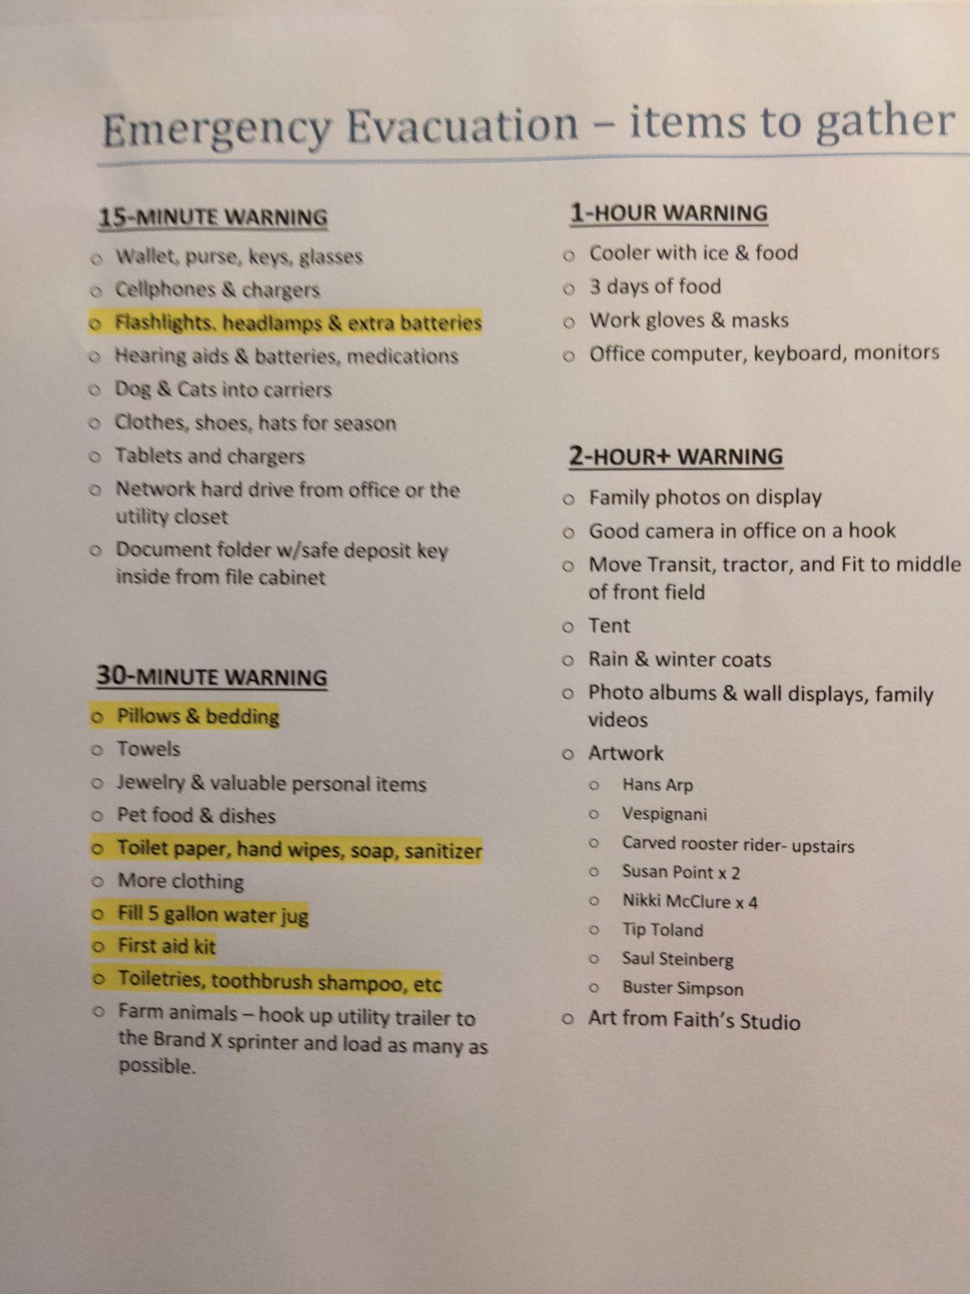
Have a Plan
Notes:
Having this important knowledge is the first step. Using that and applying it to your site to make a plan is the next step. I’ve covered lots of planning ahead actions you can take such as creating a clear ignition zone into practice, and this planning ahead also includes creating an evacuation plan for fire, flood, or other emergency.
>>
I wanted to share the example of the evacuation plan we have for our farm - this is also a home and pet evacuation plan - and we made it in 2020 when it was really smokey and fire was on our minds. You’ll see that the way we organized it was around length of time we had to prepare. The first one is for what to do if there’s only 15 minutes warning and then that list is built on with each successive increment of time. The highlighted yellow things are things that are usually kept in some vehicles so they shouldn’t need to be packed. We keep this evacuation plan tapped to the pantry cupboard so it is easy for anyone to find, familiarize themselves, and stays fresh in our minds. We re-visited it and updated in again for the 2021 fire season and will continue to do so.
This planning phase is coupled with practices we’ve put into place, which is my next topic...

Slide 10
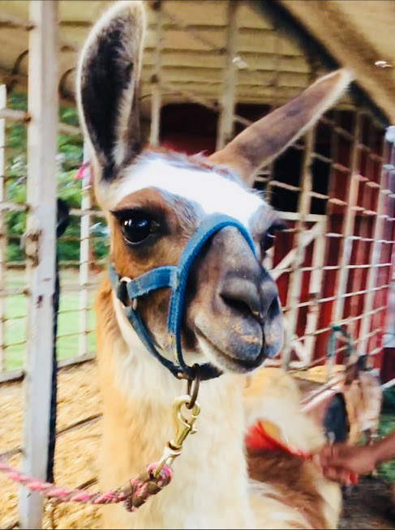
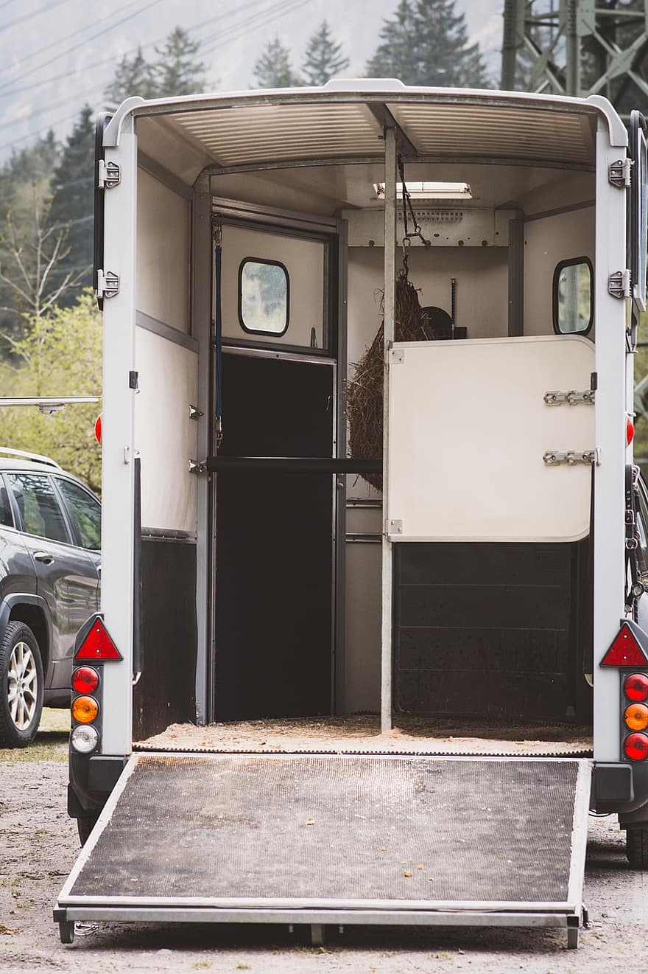
Practice
Notes:
This is my last piece this evening -
Having information and a plan in place are really great starts to being prepared for lots of different potential farm emergencies.
Practicing and having some things set up in advance are also really helpful. Examples include:
Regularly work with your livestock so they are familiar with loading into trailers, crates, or vehicles and used to having harnesses, leads, or herding animals around to help.
Practice keeping leads or herding tools in all the places you might need so if you need to corral or restrain an animal in a specific pen you always can. This is something we’ve found incredibly helpful for just daily and regular management, but would also be really helpful in an emergency as we have some sheep who are easy to catch and lead and the others will follow if we catch them and we don’t have a herding dog right now.
Have your first aid, medications, and other tools labeled and stored in such a way that you can easily collect what you need. This is is helpful for both emergencies that require evacuation and for medical emergencies that might occur on-farm.
When you first get livestock or move, form a relationship with a veterinarian. Already being an established client of a vet makes getting emergency service or on-farm calls so much easier.
Make sure your infrastructure is set up for an emergency. We’ve already talked about things like safe feed storage, ignition zones around barns and such, but another key component is having clear access ways for emergency vehicles, your own vehicles, and also making sure that opening barn latches and gate closures are easy to do for both yourself when in a hurry or for emergency responders. This is another place where having a good map that responders can refer to is important and making sure it marks things like lock combinations etc. if relevant.
You also might have some practices that you begin doing if a threat of an emergency seems imminent, for example if we are in a red-flag warning time where danger of fire is really high. For example, on our farm, we make sure that trailers are clear and in a position to easily be hooked up as soon as we know there’s a red flag warning and we re-familiarize ourselves with our evacuation packing list.
These kinds of practices help habitualize the knowledge and planning part of emergency planning so that when confronted with a real emergency you don’t need to plan in that moment when you’re not in your best thinking space and critical time won't be lost.

Slide 11
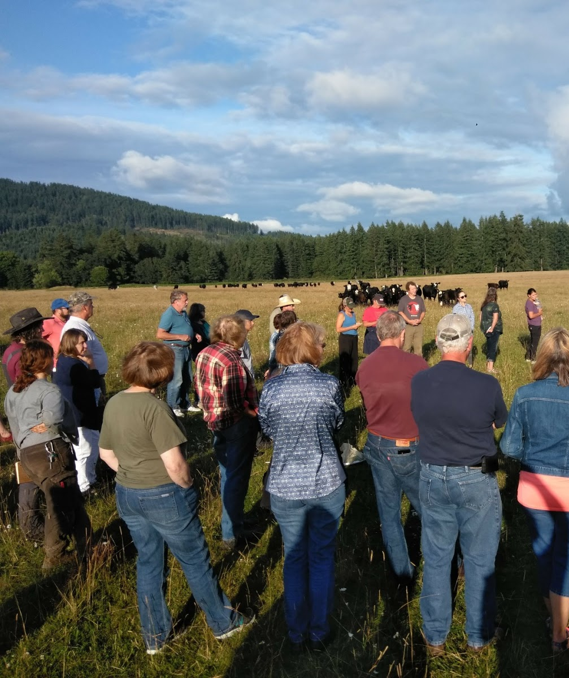
Stay in touch
Nora Carman-White nwhite@thurstoncd.com
2918 Ferguson St SW
Tumwater, WA 98512
www.thurstoncd.com
(360) 754-3588
Notes:
Tonight is a lot of information dumped at once. Please feel free to reach out with follow up questions, if you’re having a hard time finding a resource I mentioned, or if you want to talk through some preparedness ideas. I’ll hand it off now and look forward to your questions.
‹#›

